Slide 1
The software development process
30 – 08 - 18

Slide 2
How we develop software?
A Software Development Life Cycle is the term used in computing to describe the process for creating software.

Slide 3
How we Develop Software ?
There are 7 steps in Software Development
Analysis
Design
Implementation
Testing
Documentation
Evaluation
Maintenance
Most projects in software development follow this pattern.

Slide 4
Why we use a development lifecycle ?
Easier project management (date milestones, timescale, costing and controlling)
For better quality control.
Make software projects follow correct stages
Better communication between development team and client.
The activities at each stage are defined, documented and agreed (with client and project team before moving on).

Slide 5
Software Development Life Cycle (SDLC)
There are various software development life cycle models , but the step for each type is very similar.
Waterfall Lifecycle
Iterative / Incremental models

Slide 6
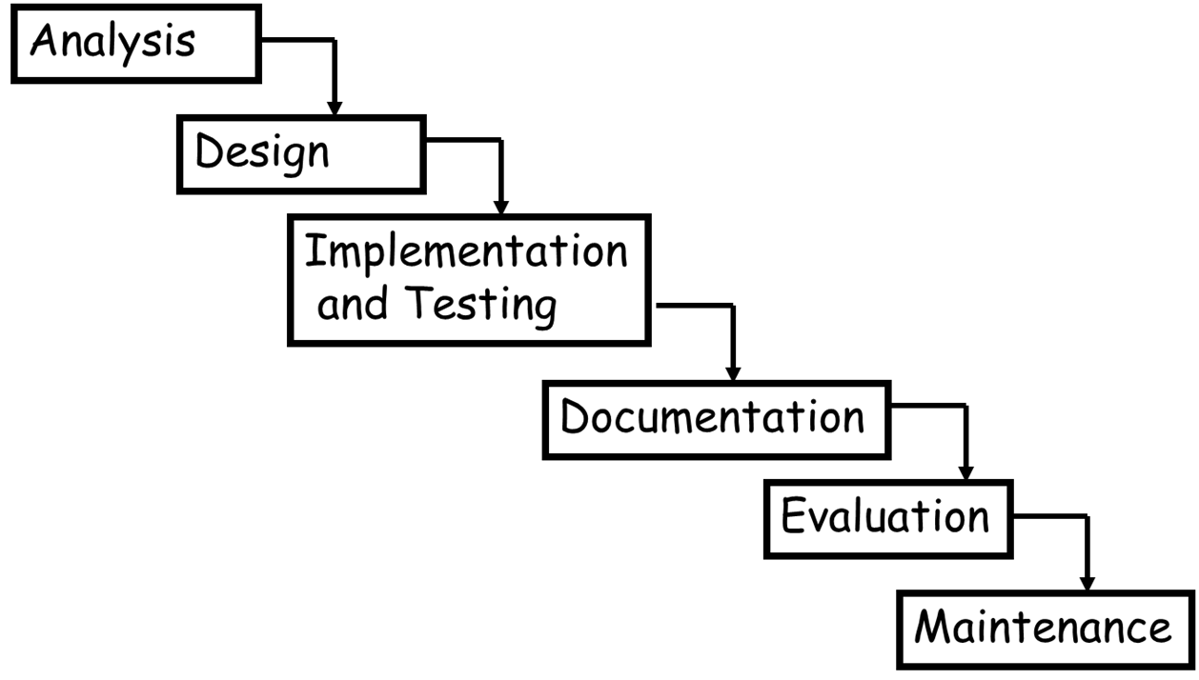
The Waterfall model (traditional)

Slide 7
The Waterfall model (traditional)
The waterfall model is a linear-sequential life cycle model.
Each phase must be completed before the next phase can begin and there is NO overlapping in the phases.

Slide 8
The Waterfall model (traditional)
Advantages:
Simple and easy to understand and use.
Works well for smaller projects where requirements are very well understood.
It is easy to manage due to the rigidity of the model – each phase has specific deliverables.
Phases do not overlap.

Slide 9
The Waterfall model (traditional)
Disadvantages:
The disadvantage of waterfall model is that it is NOT flexible. It is very difficult to go back and change something that was not well-documented or thought in the previous phase due to the rigidity of the model.
It is used only when the requirements are very well known, clear and fixed.

Slide 10
The Waterfall model (traditional)
Analysis
The main purpose of the analysis stage is to be absolutely clear about what the program is supposed to do. Often, a new program will start from a rough idea. Before getting started, it is important to turn the rough idea into an exact description of how the program will behave. What will it do? What are the inputs and the outputs? What type of computer is it to run on? All these questions, and many more, must be asked and answered at this stage.
The result of this is the production of a program specification, agreed by both the customer (whoever wants the program written) and the developer (the person or company who is developing the program).

Slide 11
Software Development Life Cycle (SDLC)
Design
During the DESIGN stage, we need to think out what the software is going to look like & how it will work
What will the software look like on screen?
How will the user interact with the software?
Buttons / Text Boxes / etc.
How will the program be structured?
How many forms are required/
During the design stage, we are DESIGNING the software. We DO NOT write any code - that comes later!

Slide 12
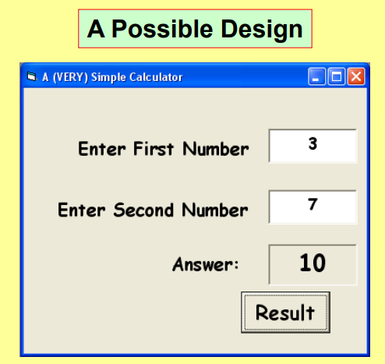
Software Development Life Cycle (SDLC)
Design

Slide 13
Software Development Life Cycle (SDLC)
Implementation
In software development, implementation is the process of converting a program design into a suitable programming language.

Slide 14
Software Development Life Cycle (SDLC)
Implementation
In software development, implementation is the process of converting a program design into a suitable programming language.
This is the job of a specialist called a COMPUTER PROGRAMMER.

Slide 15
Software Development Life Cycle (SDLC)
Testing
During the TESTING stage, we make sure the program is fit for its purpose & does what we want.
In this stage, we test for defects and deficiencies. We fix those issues until the product meets the original specifications.

Slide 16
Software Development Life Cycle (SDLC)
Testing
Suppose I had a program with a single text box. The text box will receive any number between 1 & 100.
(i) Normal Test Data
Normal Test Data would be: 10, 50, 45, 67, etc …
(ii) Extreme (Boundary) Test Data
Extreme Test Data would be 1 & 100. (At the extremes)
(iii) Exceptional Test Data
Exceptional Test Data would be 0, 234, -5, Wednesday, A,B,C etc …

Slide 17
Software Development Life Cycle (SDLC)
Documentation
During the DOCUMENTATION stage, we produce a USER GUIDE & a TECHNICAL GUIDE.
A User Guide is a document that tells the END USER how to use the software.
Sometimes it is a ‘book of instructions’ you get with a program.
It may also be an electronic manual on the CD-Rom.
It may simply be the programs help system.

Slide 18
Software Development Life Cycle (SDLC)
Documentation
The Technical Guide.
A Technical Guide is a document that tells support & maintenance staff:
How the software works & is designed.
What type of computer specification is required to run the software.
How to install the software.
How the code works.
End users won’t usually understand much of the technical guide.

Slide 19
Software Development Life Cycle (SDLC)
Evaluation
During the EVALUATION stage, we perform a Final Check before we start using the software for real.
During evaluation, we are trying to find out:-
Does the software do EVERYTHING the specification wanted?
Is the program simple & logical to use?
Are the documents clear & correct?
Is the code clear & easy to read?

Slide 20

Software Development Life Cycle (SDLC)
Maintenance
During the MAINTENANCE stage, we keep the software running & up to date.
During maintenance we
Fix any bugs that may appear with general use.
Change the software to add new features.
Update the software to work on new platforms (e.g. Windows Vista.)

Slide 21
Task 1.1 Think - Pair - share
1.1 What are Software Development Life Cycle phases?
1.2 Describe the disadvantages of the waterfall model?
1.3 What document is produced at the end of the analysis phase in SDLC?
1.4 What is Functional Requirement?
1.5 What is NON - Functional Requirement?
1.6 Describe is the difference between Functional and Non Functional requirements
1.7 What document are produced at the design stage in SDLC
1.8 what is the purpose of testing in SDLC
1.9 Use the internet to search about 3 different methods of testing in SDLC.

Slide 22
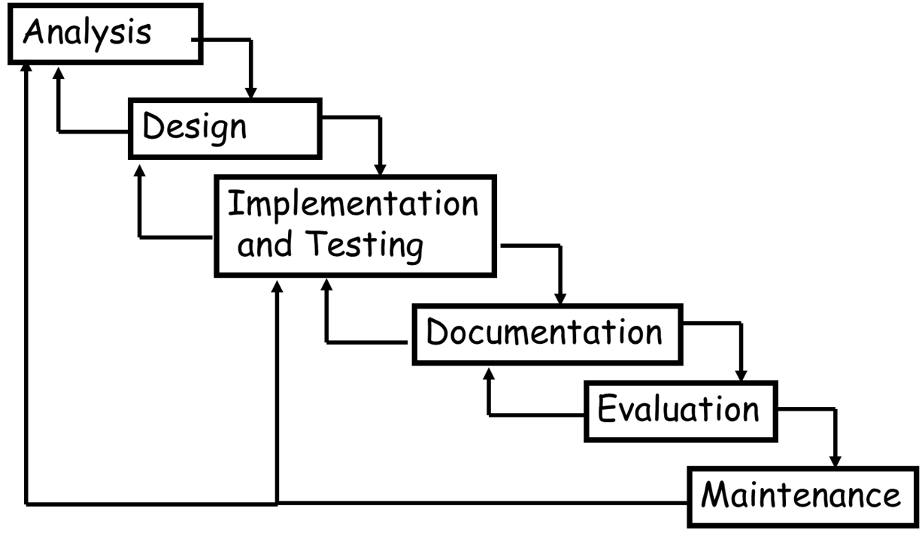
Iterative Model

